Slide 1
Data Analysis of Covid-19 (2020-2021)
Created on Tableau
File created on: 26-11-2022 18:05:24
By- Swagat S. Kalita

Slide 2
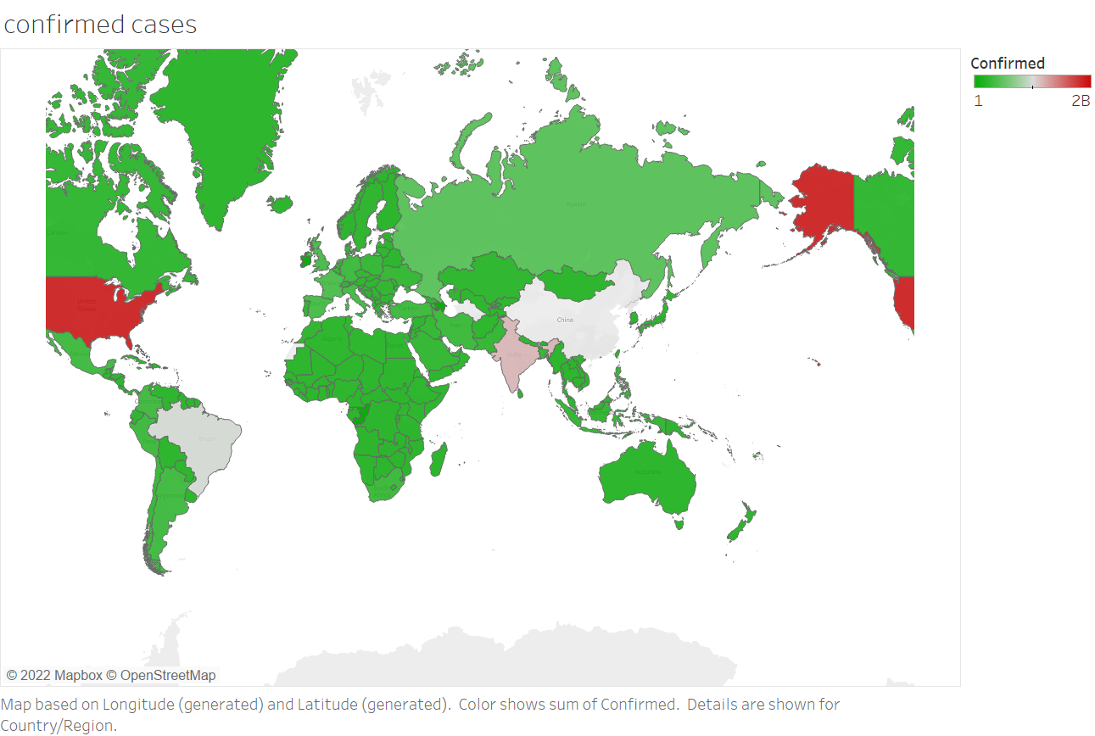

Slide 3
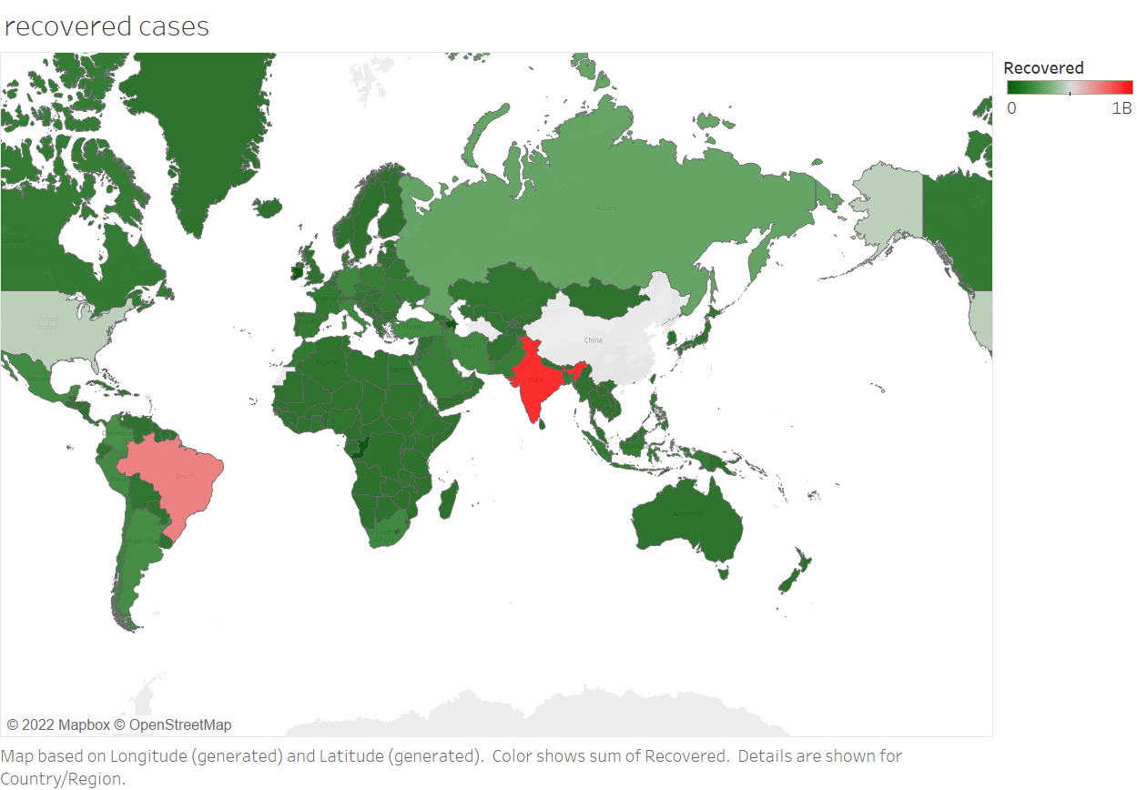

Slide 4
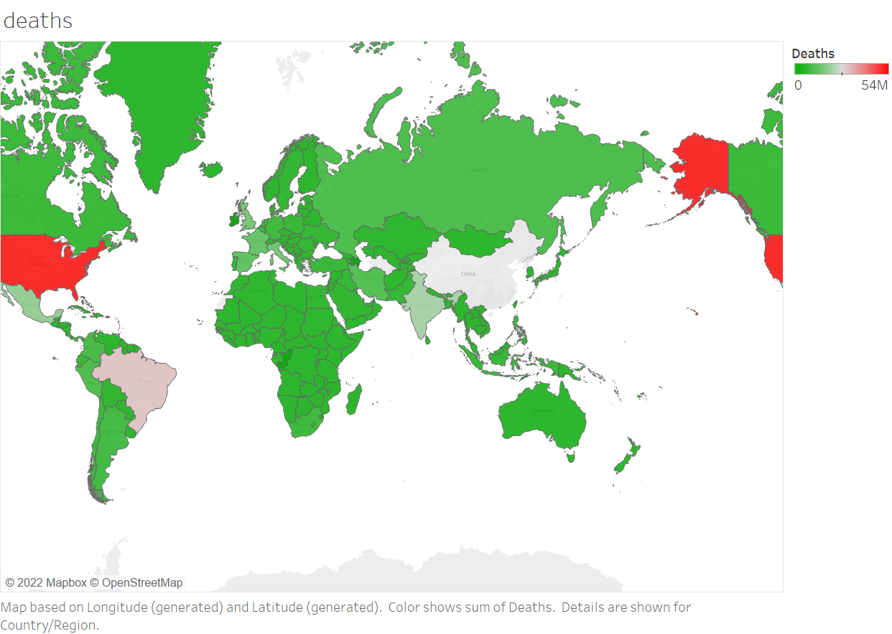

Slide 5
Data Analysis of Covid-19 in India (2020-2021)

Slide 6
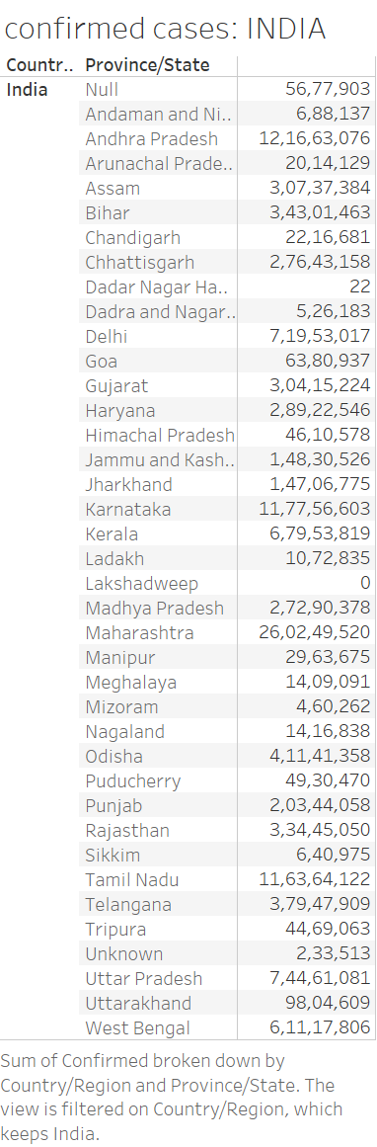

Slide 7
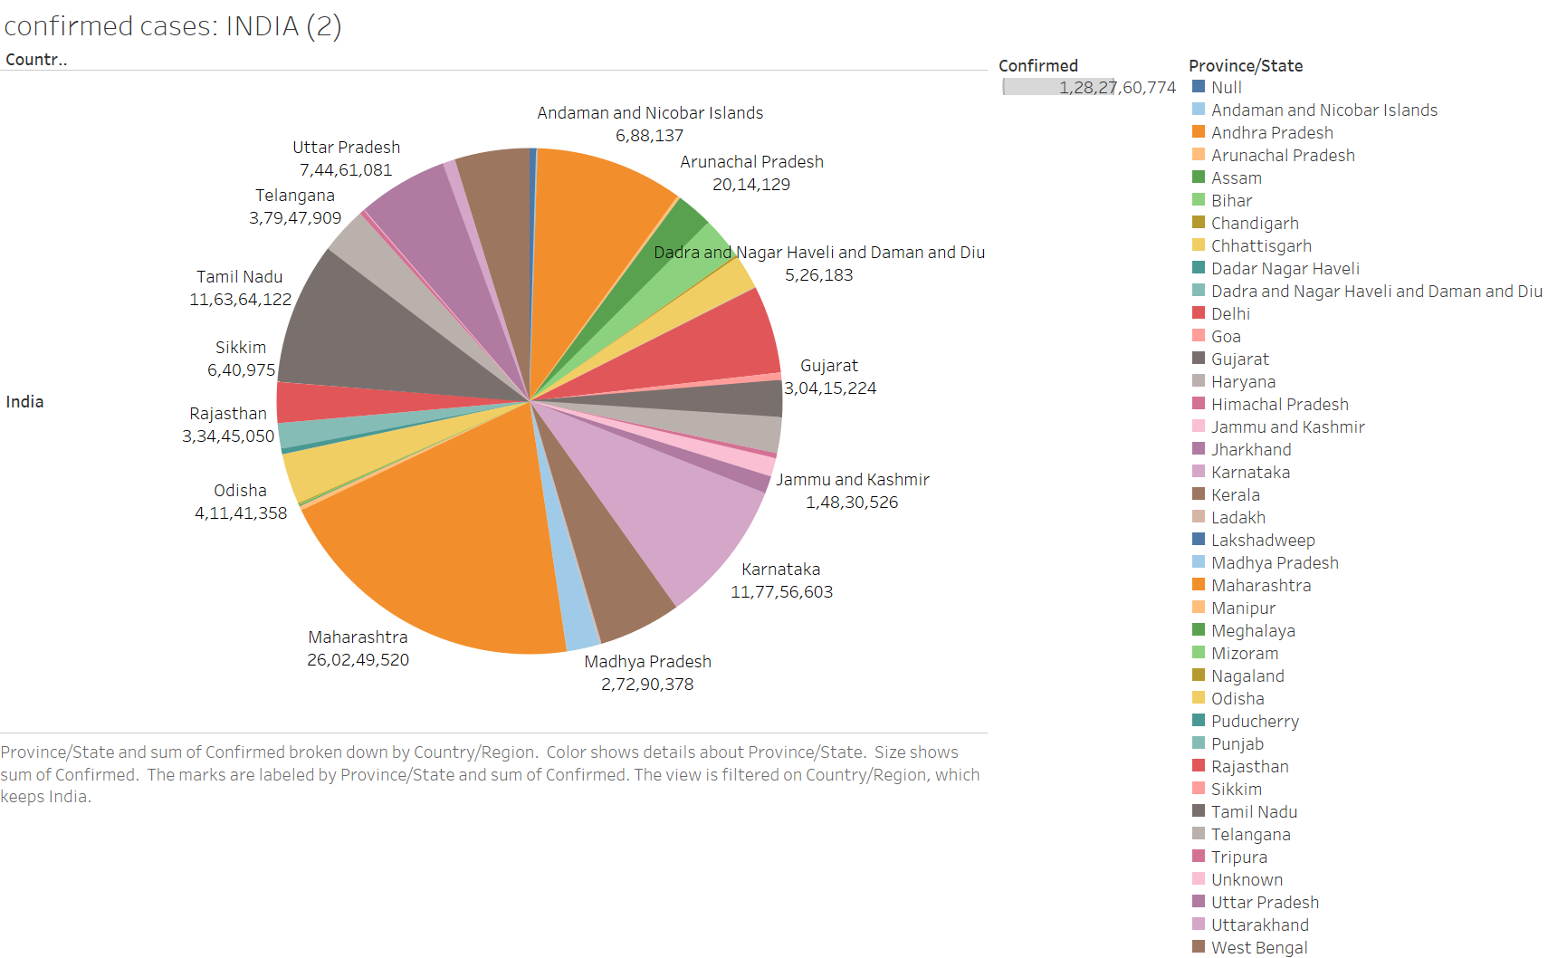

Slide 8
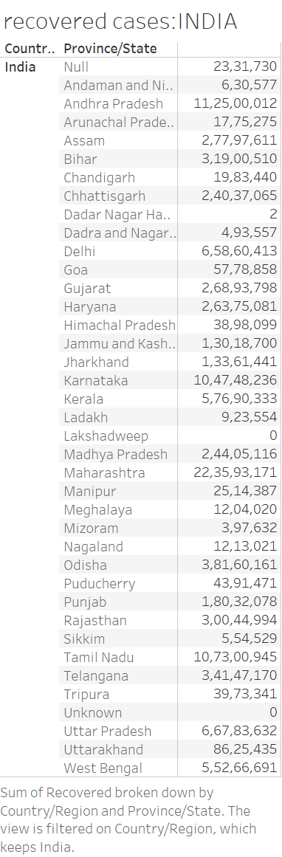

Slide 9
